Slide 1


Zain Naboulsi
06/27/2023

Slide 2

Outline
Executive Summary
Introduction
Methodology
Results
Conclusion
Appendix

Slide 3
Executive Summary
Summary of methodologies
Summary of all results

Slide 4
Introduction
Background
Commercial space travel, once exclusive to government agencies, is now a reality with companies like Virgin Galactic, Rocket Lab, Blue Origin, and SpaceX. SpaceX stands out with its Falcon 9 rocket. This rocket has cut space travel cost significantly, primarily due to its reusable first stage.
Problem Statement
A crucial question is predicting the successful landing of the first stage of a launch. This prediction can provide insights into the cost of a launch.

Slide 5

Section 1

Slide 6
Methodology
Executive Summary
Data collection methodology:
Describe how data was collected
Perform data wrangling
Describe how data was processed
Perform exploratory data analysis (EDA) using visualization and SQL
Perform interactive visual analytics using Folium and Plotly Dash
Perform predictive analysis using classification models
How to build, tune, evaluate classification models

Slide 7
Data Collection
The data for this analysis was primarily sourced from the SpaceX REST API, an open interface providing detailed information about SpaceX launches. Data, such as details about the rockets used, payload specifications, and landing outcomes, are all accessible via specific API endpoints.
In addition, web scraping techniques were employed to extract Falcon 9 launch records from relevant Wiki pages. This additional data source enriched the insights from the API data, creating a more holistic picture of the Falcon 9 launches.

Slide 8


Data Collection – SpaceX API
We use the SpaceX REST API to collect detailed data about past rocket launches. Functions access specific API endpoints, retrieve JSON data, and process this data.
For example, the `getBoosterVersion` function interacts with the 'rocket' endpoint, fetches the JSON data, and extracts the name of the rocket. In the same way, `getLaunchSite`, `getPayloadData`, and `getCoreData` functions access and pull critical details from 'launchpad', 'payloads', and 'cores' endpoints, respectively.
These steps help us create a detailed dataset from various related sources, offering useful insights into the factors that impact the success of rocket landings.
The complete Jupyter Notebook for API data gathering can be found at this GitHub URL:
https://github.com/suspicious-cow/IBM-Applied-Data-Science-Capstone/blob/main/jupyter-labs-spacex-data-collection-api.ipynb
REST Request
Function Calls
getBoosterVersion(data)
getLaunchSite(data)
getPayloadData(data)
getCoreData(data)
REST Response
JSON Data

Slide 9

Data Collection Scraping
Web scraping is a technique we use to extract information from websites.
In this case, we extract Falcon 9 historical launch records from a Wikipedia page.
This particular page contains information within an HTML table, and we utilize a tool named BeautifulSoup to parse this data. Once the table is parsed, we convert this data into a DataFrame. The DataFrame structure allows us to further analyze and visualize the data, paving the way for insightful discoveries about Falcon 9 launch records.
https://github.com/suspicious-cow/IBM-Applied-Data-Science-Capstone/blob/main/jupyter-labs-webscraping.ipynb

Slide 10
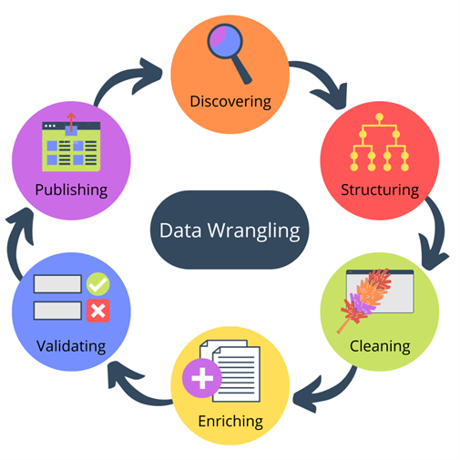
Data Wrangling
Data wrangling involves refining raw data into a more usable format.
As part of our analysis, we conduct Exploratory Data Analysis (EDA) to detect patterns, spot anomalies, or test hypotheses.
A critical aspect of this process involves determining labels for our supervised models.
Our dataset has instances where the Falcon 9 booster did not land as planned. These outcomes fall into various categories, such as successful or unsuccessful landing on ocean, ground pad, or drone ship, denoted by terms like 'True Ocean', 'False Ocean', 'True RTLS', 'False RTLS', 'True ASDS', and 'False ASDS’.
For simplicity and ease of modeling, we transform these outcomes into training labels. '1' indicates a successful landing, while '0' signifies an unsuccessful one. This transformation will aid in the development of predictive models in later stages.
https://github.com/suspicious-cow/IBM-Applied-Data-Science-Capstone/blob/main/labs-jupyter-spacex-Data%20wrangling.ipynb

Slide 11
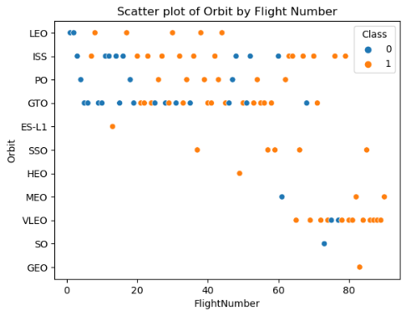
EDA with Data Visualization
We charted various parameters against each other to understand their impact on launch success. The 'FlightNumber' against 'PayloadMass' plot showed an increased likelihood of first stage landing with increasing flight numbers, but a decreasing success rate with heavier payloads.
Examining success rates by launch sites, we found variances 'CCAFS LC-40' had a 60% success rate, while 'KSC LC-39A' and 'VAFB SLC 4E' had 77%. This was visualized using a 'catplot' with 'FlightNumber' and 'LaunchSite' on the axes, and the success class as the hue.
Investigating the relationship between launch sites and payload mass, we discovered that the 'VAFB-SLC' site hadn't launched any rockets for payloads over 10000.
A relationship was also sought between success rate and orbit type through a bar chart. It indicated that certain orbits had a higher success rate. The scatterplot of 'FlightNumber' against 'Orbit' type showed a relationship between success and flight numbers in 'LEO' orbit but not in 'GTO' orbit.
Finally, examining payload mass against orbit type, we found that successful landings were more frequent for 'Polar', 'LEO', and 'ISS' with heavier payloads, while 'GTO' had both successful and unsuccessful missions.
The trend line charting 'Year' against the average success rate demonstrated a steadily increasing success rate from 2013 to 2020. Overall, these visualizations provided insights into the factors that may influence the success of a launch.
https://github.com/suspicious-cow/IBM-Applied-Data-Science-Capstone/blob/main/jupyter-labs-eda-dataviz.ipynb

Slide 12
EDA with SQL
Identified unique launch sites involved in the space mission to understand the diversity of launch locations, essential for assessing geographical dependencies and operational flexibility.
Showcased five records of launch sites starting with 'CCA' to illustrate the data consistency and validate naming conventions in the dataset, crucial for maintaining data integrity.
Calculated the total payload mass carried by boosters launched by NASA (CRS) to assess the partnership's contribution to SpaceX's total payload volume, important for strategic partnership evaluations.
Determined the average payload mass carried by the 'F9 v1.1' booster version to quantify its payload capacity, fundamental in performance comparison against other booster versions.
Identified the date when the first successful ground pad landing was achieved to mark the milestone in SpaceX's reusability program, critical for tracking technological advancements and operational efficiency.
Listed the names of boosters that had successful landings on a drone ship and carried a payload mass between 4000 and 6000 kg to highlight specific booster performances under defined conditions, relevant for fine-tuning future missions.
Counted the total number of successful and failed mission outcomes to assess overall mission success rate, imperative for evaluating company performance and guiding future mission planning.
Listed booster versions carrying the maximum payload mass to identify the high-performance variants, essential for optimizing mission design considering payload requirements.
Showcased records displaying the month names, failure landing outcomes in drone ship, booster versions, and launch sites for the year 2015 to provide a detailed performance report for that year, useful for year-over-year performance comparisons.
Ranked the count of various landing outcomes from June 4, 2010, to March 20, 2017, to analyze the trend and success rate over a specific period, necessary for trend analysis and predicting future success rates.
https://github.com/suspicious-cow/IBM-Applied-Data-Science-Capstone/blob/main/jupyter-labs-eda-sql-coursera_sqllite.ipynb

Slide 13
Build an Interactive Map with Folium
Summarize what map objects such as markers, circles, lines, etc. you created and added to a folium map
Explain why you added those objects
Add the GitHub URL of your completed interactive map with Folium map, as an external reference and peer-review purpose

Slide 14
Build a Dashboard with Plotly Dash
Summarize what plots/graphs and interactions you have added to a dashboard
Explain why you added those plots and interactions
Add the GitHub URL of your completed Plotly Dash lab, as an external reference and peer-review purpose

Slide 15
Predictive Analysis (Classification)
Summarize how you built, evaluated, improved, and found the best performing classification model
You need present your model development process using key phrases and flowchart
Add the GitHub URL of your completed predictive analysis lab, as an external reference and peer-review purpose

Slide 16
Results
Exploratory data analysis results
Interactive analytics demo in screenshots
Predictive analysis results

Slide 17

Section 2

Slide 18
Flight Number vs. Launch Site
Show a scatter plot of Flight Number vs. Launch Site
Show the screenshot of the scatter plot with explanations

Slide 19
Payload vs. Launch Site
Show a scatter plot of Payload vs. Launch Site
Show the screenshot of the scatter plot with explanations

Slide 20
Success Rate vs. Orbit Type
Show a bar chart for the success rate of each orbit type
Show the screenshot of the scatter plot with explanations

Slide 21
Flight Number vs. Orbit Type
Show a scatter point of Flight number vs. Orbit type
Show the screenshot of the scatter plot with explanations

Slide 22
Payload vs. Orbit Type
Show a scatter point of payload vs. orbit type
Show the screenshot of the scatter plot with explanations

Slide 23
Launch Success Yearly Trend
Show a line chart of yearly average success rate
Show the screenshot of the scatter plot with explanations

Slide 24
All Launch Site Names
Find the names of the unique launch sites
Present your query result with a short explanation here

Slide 25
Launch Site Names Begin with 'CCA'
Find 5 records where launch sites begin with `CCA`
Present your query result with a short explanation here

Slide 26
Total Payload Mass
Calculate the total payload carried by boosters from NASA
Present your query result with a short explanation here

Slide 27
Average Payload Mass by F9 v1.1
Calculate the average payload mass carried by booster version F9 v1.1
Present your query result with a short explanation here

Slide 28
First Successful Ground Landing Date
Find the dates of the first successful landing outcome on ground pad
Present your query result with a short explanation here

Slide 29
Successful Drone Ship Landing with Payload between 4000 and 6000
List the names of boosters which have successfully landed on drone ship and had payload mass greater than 4000 but less than 6000
Present your query result with a short explanation here

Slide 30
Total Number of Successful and Failure Mission Outcomes
Calculate the total number of successful and failure mission outcomes
Present your query result with a short explanation here

Slide 31
Boosters Carried Maximum Payload
List the names of the booster which have carried the maximum payload mass
Present your query result with a short explanation here

Slide 32
2015 Launch Records
List the failed landing_outcomes in drone ship, their booster versions, and launch site names for in year 2015
Present your query result with a short explanation here

Slide 33
Rank Landing Outcomes Between 2010-06-04 and 2017-03-20
Rank the count of landing outcomes (such as Failure (drone ship) or Success (ground pad)) between the date 2010-06-04 and 2017-03-20, in descending order
Present your query result with a short explanation here

Slide 34

Section 3

Slide 35
<Folium Map Screenshot 1>
Replace <Folium map screenshot 1> title with an appropriate title
Explore the generated folium map and make a proper screenshot to include all launch sites’ location markers on a global map
Explain the important elements and findings on the screenshot

Slide 36
<Folium Map Screenshot 2>
Replace <Folium map screenshot 2> title with an appropriate title
Explore the folium map and make a proper screenshot to show the color-labeled launch outcomes on the map
Explain the important elements and findings on the screenshot

Slide 37
<Folium Map Screenshot 3>
Replace <Folium map screenshot 3> title with an appropriate title
Explore the generated folium map and show the screenshot of a selected launch site to its proximities such as railway, highway, coastline, with distance calculated and displayed
Explain the important elements and findings on the screenshot

Slide 38

Section 4

Slide 39
<Dashboard Screenshot 1>
Replace <Dashboard screenshot 1> title with an appropriate title
Show the screenshot of launch success count for all sites, in a piechart
Explain the important elements and findings on the screenshot

Slide 40
<Dashboard Screenshot 2>
Replace <Dashboard screenshot 2> title with an appropriate title
Show the screenshot of the piechart for the launch site with highest launch success ratio
Explain the important elements and findings on the screenshot

Slide 41
<Dashboard Screenshot 3>
Replace <Dashboard screenshot 3> title with an appropriate title
Show screenshots of Payload vs. Launch Outcome scatter plot for all sites, with different payload selected in the range slider
Explain the important elements and findings on the screenshot, such as which payload range or booster version have the largest success rate, etc.

Slide 42

Section 5

Slide 43
Classification Accuracy
Visualize the built model accuracy for all built classification models, in a bar chart
Find which model has the highest classification accuracy

Slide 44
Confusion Matrix
Show the confusion matrix of the best performing model with an explanation

Slide 45
Conclusions
Point 1
Point 2
Point 3
Point 4
…

Slide 46
Appendix
Include any relevant assets like Python code snippets, SQL queries, charts, Notebook outputs, or data sets that you may have created during this project

Slide 47


